Slide 1
The Giving Society
What makes a country more generous?
Nealey Bell

Slide 2
Generosity

Slide 3
The Data:
World Happiness Report 2019

Slide 4
Please note: the highest or best ranking is 1 – so the lower the mean the better the actual rankings.

Slide 5
Universal Health Care: all people and communities can use health services they need, while ensuring the use of these services does not expose the user to financial hardship.

Slide 6
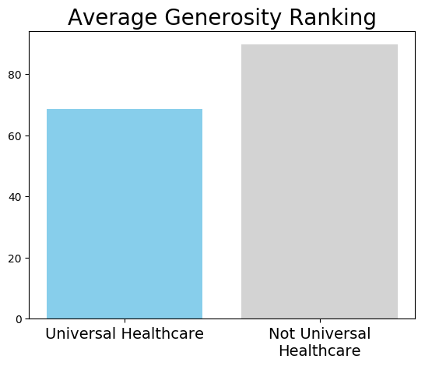
89.7
68.6

Slide 7
Happiness: ranked on the Cantril Ladder, where respondents are asked to picture a ladder where the best life is a 10 and the worst is a 0.

Slide 8
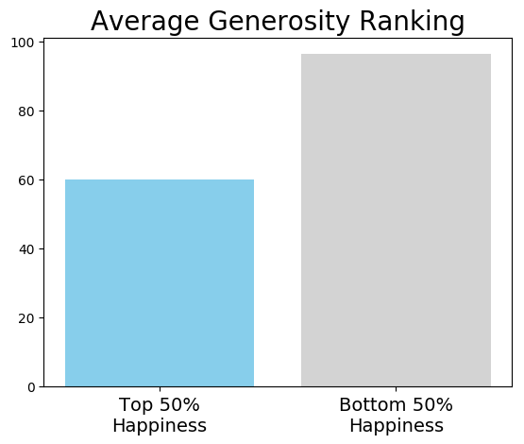
96.4
60.0

Slide 9
Social Support: the national average of the binary responses (0 or 1) to the question, “If you were in trouble, do you have relatives or friends you can count on to help you whenever you need them, or not?”

Slide 10
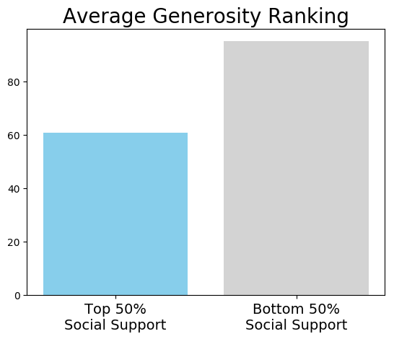
94.9
60.8

Slide 11
Freedom: national average of binary responses (0 or 1) to the question, “Are you satisfied or dissatisfied with your freedom to choose what you do with your life?”

Slide 12
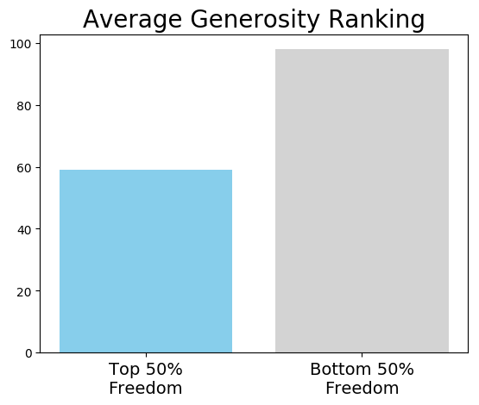
97.9
59.1

Slide 13
Life Expectancy: the average period a person may expect to live

Slide 14
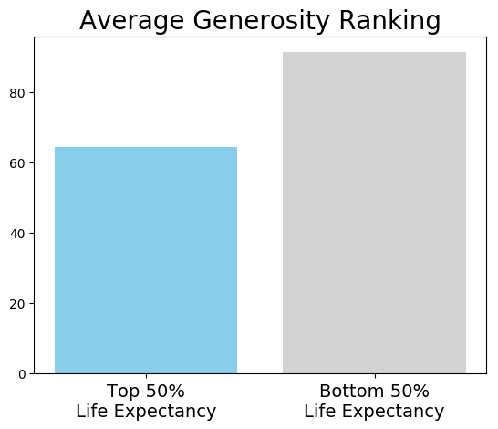
91.2
64.3

Slide 15
Gross Domestic Product: the value of economic activity within a country

Slide 16
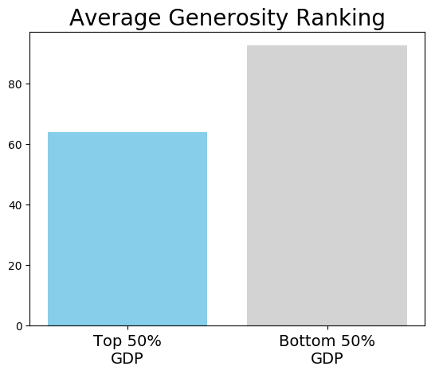
92.5
64.0

Slide 17
Benefits

Slide 18
Questions?

